Slide 1
DEVELOPING THE SAFETY FEATURES IN VEHICLE USING STM32

Slide 2
PROJECT DESCRIPTION
To develop a Real Time application to implement safety in the car. This project provides a variety of features and automation features in the car such features are Power windows like temperature monitoring in interior of the car. And Door open and Close monitoring, window open/close monitoring, It helps to indicate the user. And also automating the car and increase the safety features. In this project, we used Potentiometer instead of LM35 for monitoring temperature and IR sensor for detecting whether the door is closed or opened.

Slide 3
BLOCK DIAGRAM
BUZZER
STM32F405RGT6
Microcontroller
SWITCH
IR
LCD DISPLAY
16X2
POTENTIOMETER
LED

Slide 4
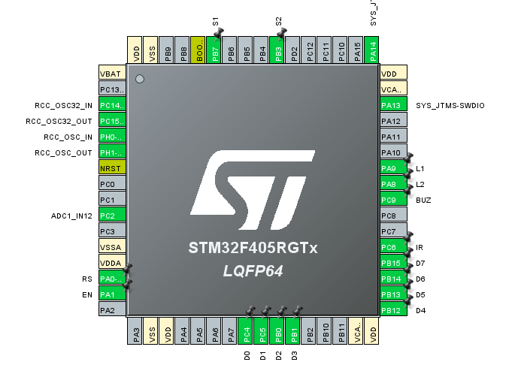
IOC DIAGRAM

Slide 5
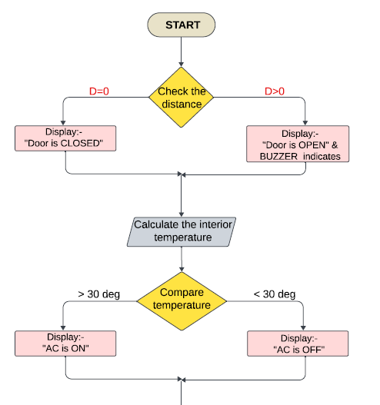
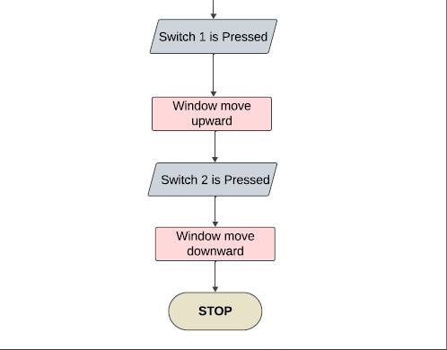
FLOWCHART

Slide 6
MAPPING
COMPONENTS | INPUT/OUTPUT | FUNCTION
IR SENSOR | INPUT | To check whether the door is closed or opened
LCD DISPLAY 16X2 | OUTPUT | To display the output
POTENTIOMETER | INPUT | To vary the temperature instead of using lm35
LED | OUTPUT | To check the window is opened or closed
SWITCH | INPUT | Used for closing and opening windows
BUZZER | OUTPUT | Indicates if door is opened

Slide 7
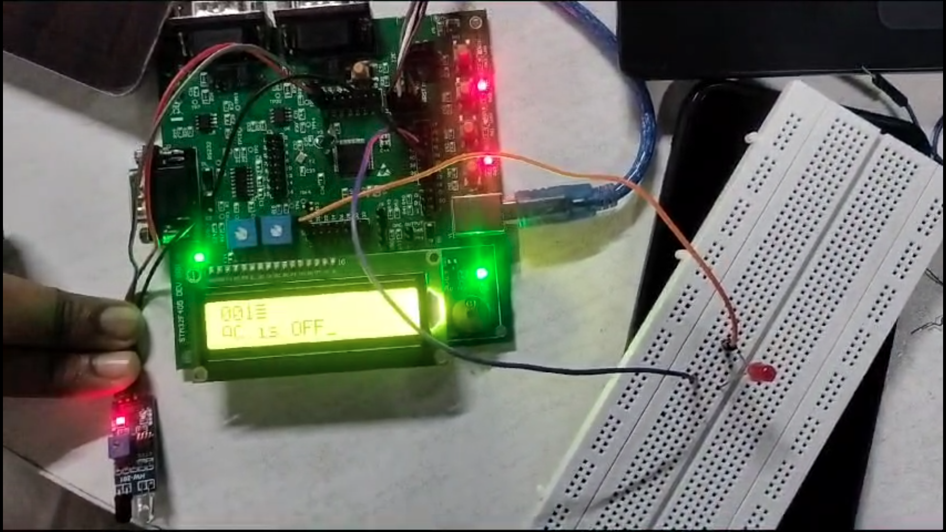
PROTOTYPE - IMAGE

Slide 8
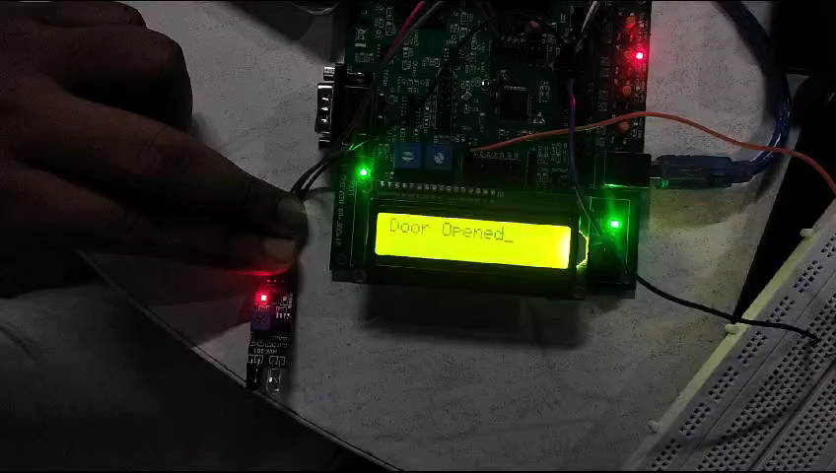
DEMO VIDEO

Slide 9
THANK
YOU

